Slide 1

Credit EDA Case Study
Submitted By:
Shreyansha Tai Sonwane

Slide 2
PROBLEM STATEMENT
Two types of risks are associated with the bank’s decision:
TARGET(0): If the applicant is likely to repay the loan, then not approving the loan results in a loss of business to
the company
TARGET(1): If the applicant is not likely to repay the loan, i.e. he/she is likely to default, then approving the loan
may lead to a financial loss for the company.
ANALYSIS OF DATA IS DONE IN PYTHON ON A JUPITER NOTEBOOK

Slide 3
DATA PRE PROCESSING
STEPS:
Check the structure of data (shape, size, info, describe)
Check for missing value columns (which should be dropped, which should be handled and how, and which should be left alone).
Drop/Remove any columns that aren't relevant to the TARGET variable

Slide 4
Check each column's data type, and fix any columns with an inappropriate data type or a binary categorical column (into 0 and 1)
Check outliers and data imbalance .
Binning of continuous variables as required during analysis
Top 10 correlation for defaulter and non defaulter

Slide 5
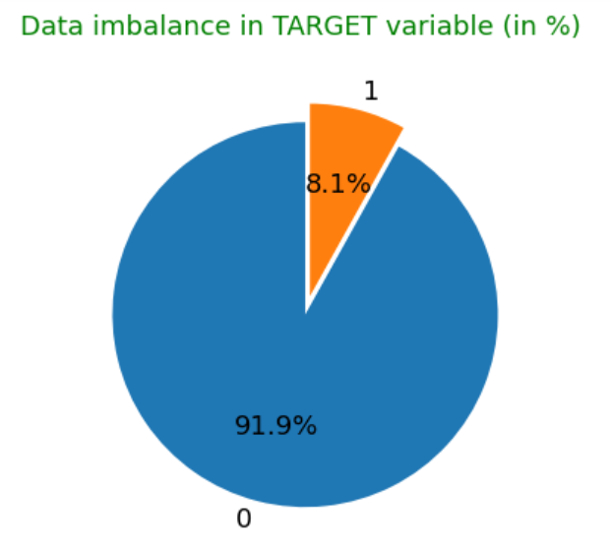
Defaulter-8.1%
Non-defaulter-91.9%

Slide 6
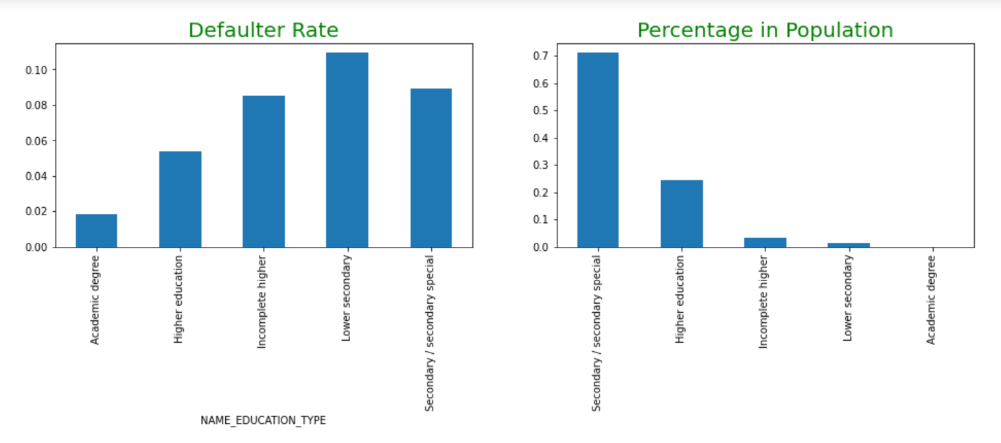
Higher default rate in lower secondary and least default rate in academic degree
(default rate falls with education)

Slide 7
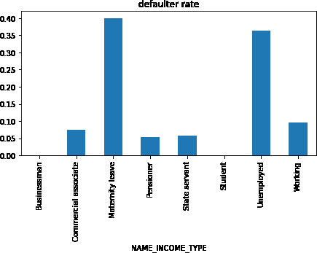
Student and buissnessman are safest.
Women in maternity leave and Unemployeds had highest default rate

Slide 8
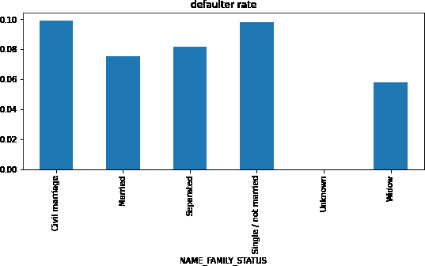
Civil married and singles are risky
Widows are safest

Slide 9
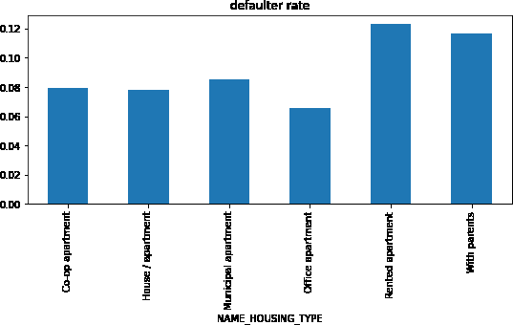
People living at rented apartment and with
Parents are highly risky
People living at office apartment are least at risk

Slide 10
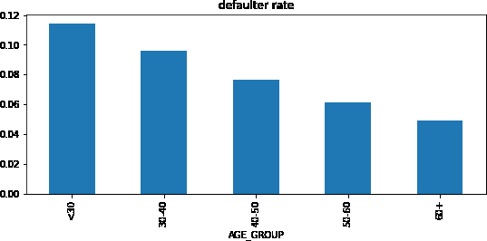
Default rate fall with age.
People(<30) had highest default rate 3)people(>60) had least default rate

Slide 11
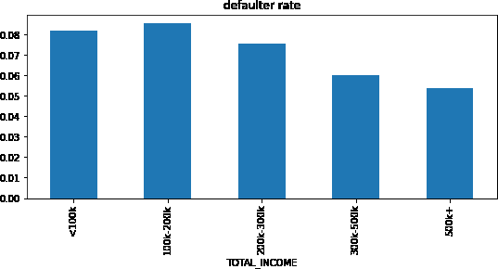
Default rate fall with income.
People having income <200k are highest risky
People with income >500k are safest

Slide 12
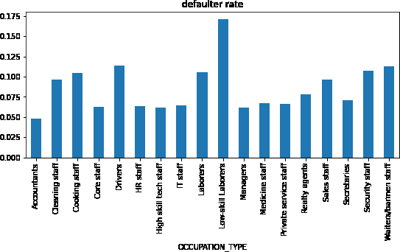
low skill labours(highest),waiters,drivers,labourers defaulter rate is high
accountant,core staff,hr staff,IT staffs are safest

Slide 13
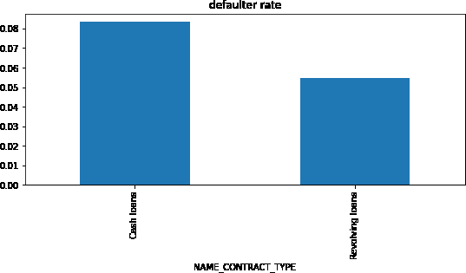
Defaulter seem to apply for cash loan
non-defaulter applies for revolving loans

Slide 14
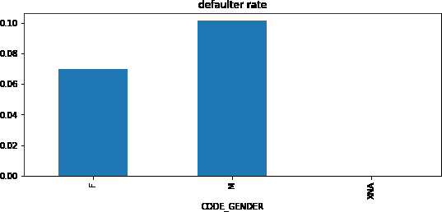
Males seem to be more prone to default

Slide 15
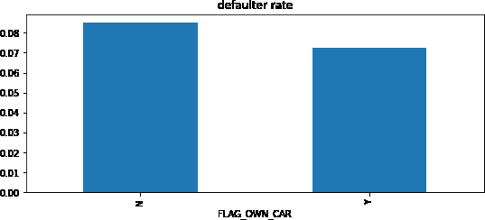
1)Those who don’t have car are more prone
To default

Slide 16
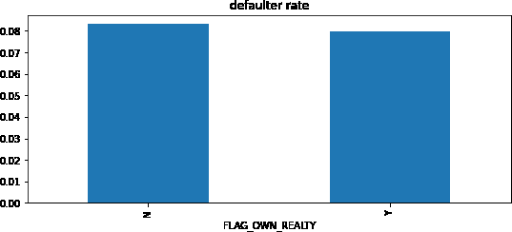
1)Those who don’t own flat/house had high
Chance of default

Slide 17
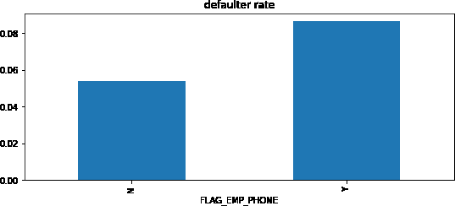
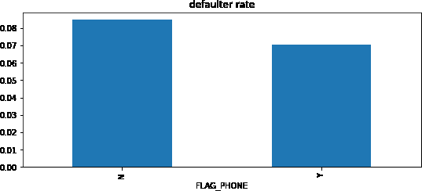
Defaulter had a tendency of giving work phone but not home phone in application

Slide 18
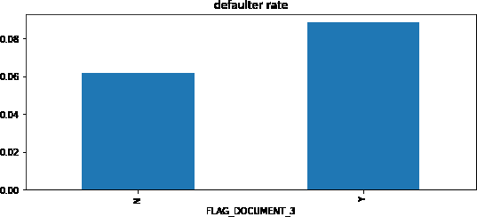
1)People who submitted document 3 had high Default rate

Slide 19
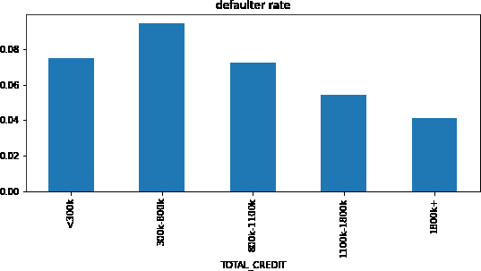
Default rate fall with credit amount.
Highest default rate(300k-800k)
Lowest default rate(>1800k)

Slide 20
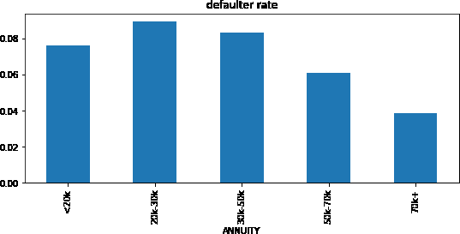
Default rate fall with annuity amount.
Highest default rate(20k-30k)
Lowest default rate(>70k)

Slide 21
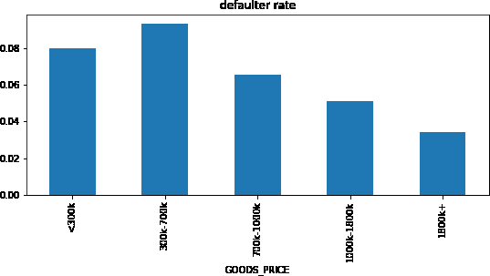
Default rate fall with goods_price.
Highest default rate(300k-700k)
Lowest default rate(>1800k)
So credit,annuity and good_price showing very High correlation

Slide 22
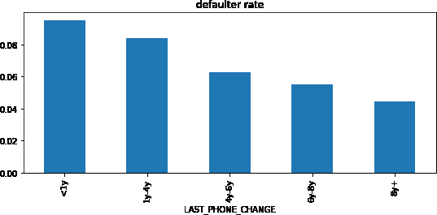
Defaulter seem to change their phone before
Applying
People who changed(<1y)
People who changed(>8y) are least defaulter

Slide 23
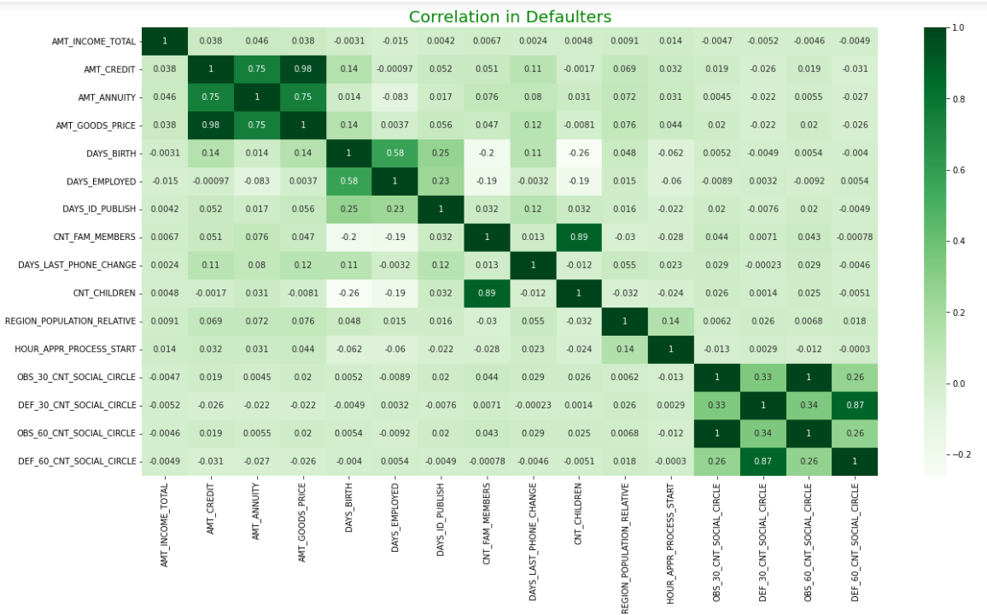

Slide 24
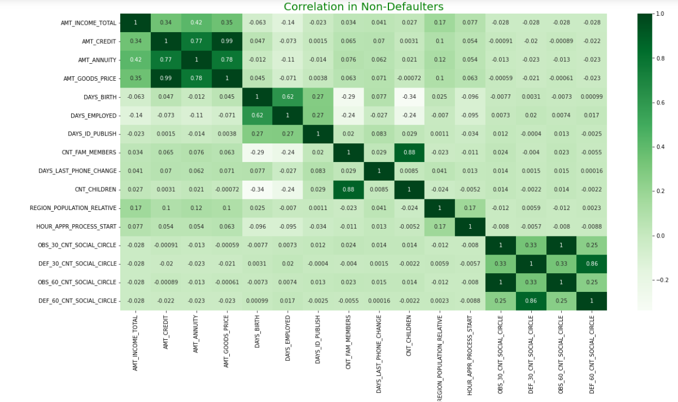

Slide 25
Top 10 Correlation For Defaulters
amt_credit vs amt_goods_price(corr=0.98)
cnt_family_member vs cnt_children(corr=0.89) 3)DEF_30_CNT_SOCIAL_CIRCLE vs DEF_60_CNT_SOCIAL_CIRCLE(corr=0.87)
amt_credit vs amt_annuity(corr=0.75) 5)amt_annuity vs amt_goods_price(corr=0.75) 6)days_birth vs days_employed(corr=0.58)
DEF_30_CNT_SOCIAL_CIRCLE vs OBS_60_CNT_SOCIAL_CIRCLE(corr=0.34)
DEF_30_CNT_SOCIAL_CIRCLE vs OBS_30_CNT_SOCIAL_CIRCLE(corr=0.33)
DEF_60_CNT_SOCIAL_CIRCLE vs OBS_30_CNT_SOCIAL_CIRCLE(corr=0.26)
days_birth vs days_id_publish(corr=0.25)

Slide 26
Top 10 Correlation In Non-defaulter
amt_credit vs amt_goods_price(corr=0.99)
cnt_family_member vs cnt_children(corr=0.88) 3)DEF_30_CNT_SOCIAL_CIRCLE vs DEF_60_CNT_SOCIAL_CIRCLE(corr=0.86)
4)amt_annuity vs amt_goods_price(corr=0.78) 5)amt_credit vs amt_annuity(corr=0.77) 6)days_birth vs days_employed(corr=0.63)
DEF_30_CNT_SOCIAL_CIRCLE vs OBS_60_CNT_SOCIAL_CIRCLE(corr=0.33)
DEF_30_CNT_SOCIAL_CIRCLE vs OBS_30_CNT_SOCIAL_CIRCLE(corr=0.33)
days_employed vs days_id_publish(corr=0.28)
DEF_60_CNT_SOCIAL_CIRCLE vs OBS_30_CNT_SOCIAL_CIRCLE(corr=0.25)
observation-sequence of top 10 correlation in defaulter and non-defaulter is almost same

Slide 27
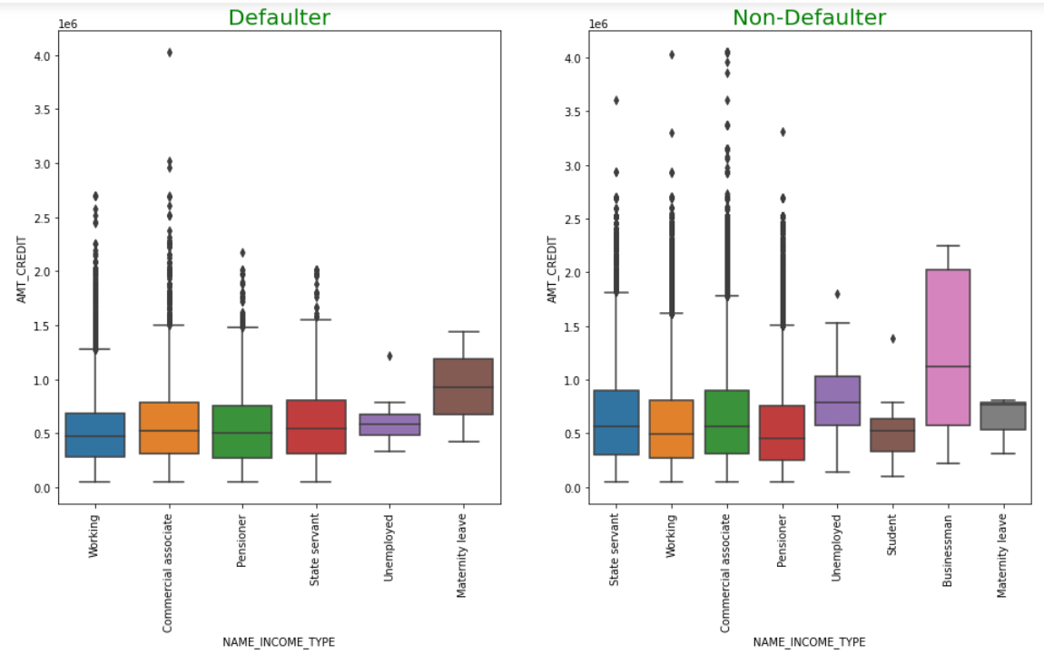

Slide 28
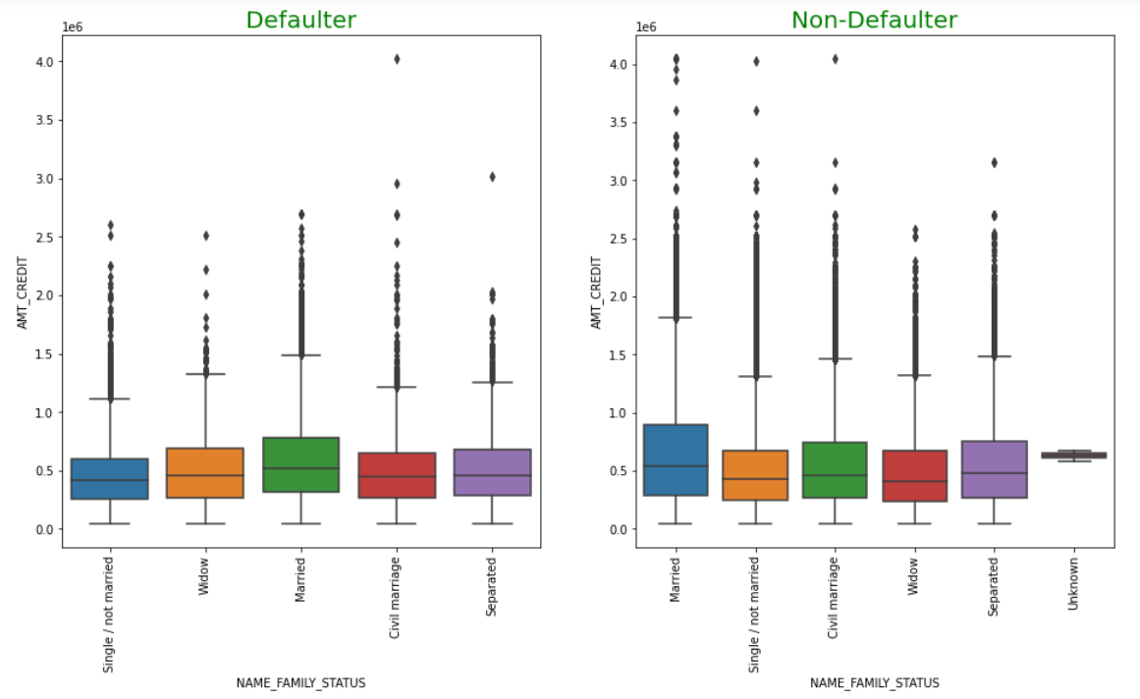

Slide 29
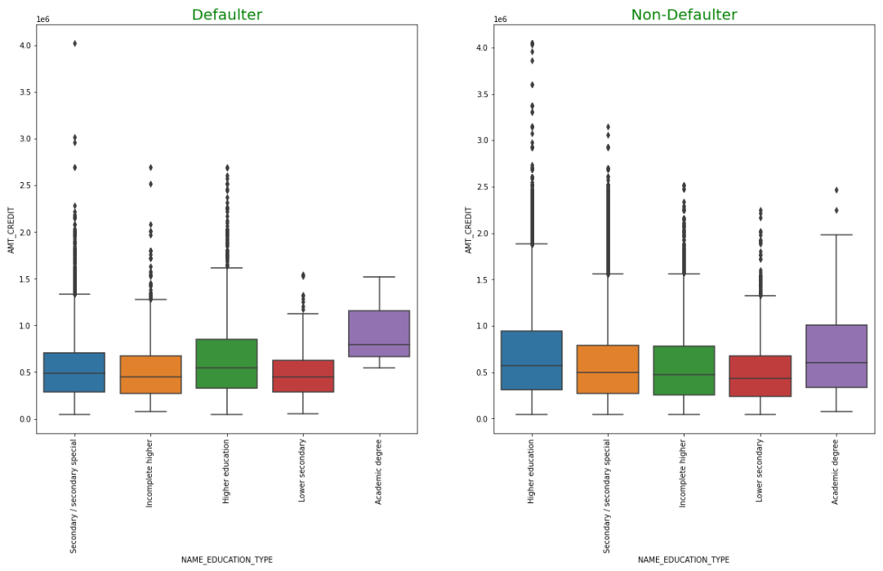

Slide 30
OBSERVATIONS
Married person are comparative safe to give loan, only when you are giving above 800k credit (just increase credit amount to ensure further more safety)
Women who sought for high credit while on maternity leave had a very high chance of defaulting.
To give small credit loan (below 800k), students are good choice.

Slide 31
Unemployed people are comparatively safer to give big credit (above 800k)
Below 500k credit, person with academic degree is very safe
For giving loan to person with secondary education go beyond 1000k (toward high credit)
Person with lower secondary education is high risk, choosing those who ask for credit beyond 1500k ensure safety

Slide 32

as you move toward higher days of
employment,defaulting chance reduces

Slide 33
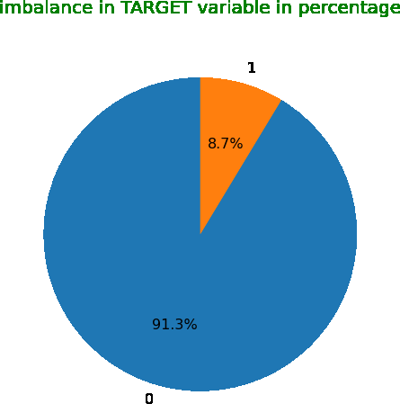
For previous applicants,8.7% are defaults

Slide 34
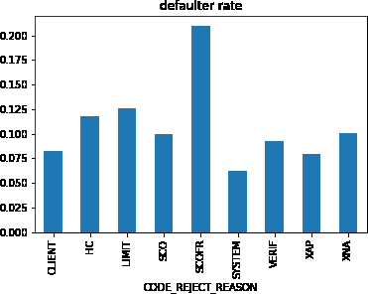
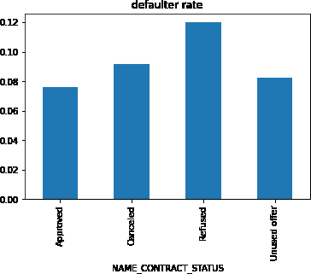
Previous data insights

Slide 35
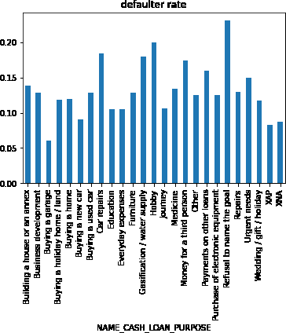
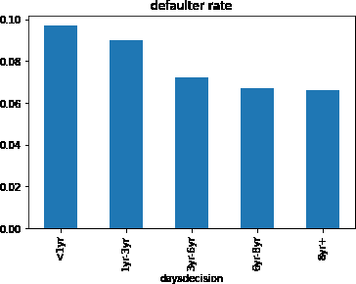

Slide 36
CONCLUSIONS ABOUT DEFAULTERS
To begin with, roughly 8% of the population is found to be defaulters, with men being more likely than women to be defaulters.
Income: With a decrease in income, the default rate rises. People with a total income of less than 200,000 are the most vulnerable.
Income type: The highest default rates were among the unemployed (second highest defaulter rate) and pregnant women (highest defaulter rate).
Education: Persons with lower secondary education and then secondary education had the greatest default rate, so people with lower secondary education and then secondary education had the highest default rate
Age: The rate of defaulters decreases with age, therefore persons under 30 and then in their 30s had the highest default rate.

Slide 37
Occupation type: The default rate was higher among low-skilled workers. Other serving classes, such as waiters, drivers, and labourers, are also at risk.
House/flat: People who did not own real estate (a house or a flat) were more likely to default.
Family status: Civil married people have the highest defaulter rate, followed by single people (second)
Employment_days: People who had lately been employed had the highest risk of default.
Own_car: People who did not own a car were more likely to default.
Housing status: The biggest percentage of defaulters were those who lived in rented apartments, followed by those who lived with their parents.

Slide 38
Changing phone: The defaulter had a habit of switching phones right before the application. People who change phones frequently (1 year) are at the greatest risk. With time, the default rate diminishes.
Total_credit: Those who asked for loan between 3 lacs and 8 lacs had the greatest default rate; however, as credit amounts increase, the default rate decreases.
Annuity and goods price: following same trend as credit, people with annuity (20k-30k) and good price (300k-700k) had the highest default rate, which fell as the value increased.
Contract type: A large percentage of persons who applied for a cash loan defaulted.

Slide 39
Doc_3: The default rate was greater among those who submitted this document
17) Defaulters appear to apply for subsequent loans more quickly than non-defaulters.
18) As noticed, defaulters had a tendency to refuse to disclose the purpose for which they requested for a cash loan.
19) There is a pattern in defaulter where they provide work phone but not home phone.
20) Women who sought for high credit while on maternity leave had a very high likelihood of defaulting.
21) In the majority of cases, people who were refused in the previous application due to the reject code SCOFR became defaulters.

Slide 40
CONCLUSION ABOUT NON-DEFAULTERS
To begin with, roughly 92% of the population is determined to be non-defaulters, with females being more likely than males to be non-defaulters.
Income: The default rate decreases as income rises. People with a total income of more than 500k are the ones who are least at risk.
Income type: Non-defaulters are most likely to be students and business owners (minimum risk)
Education: The probability of not defaulting increases with education level, therefore persons with a college education had the lowest risk of default.
Age: The rate of defaulters decreases with age, hence those over 60 are the least likely to default.

Slide 41
Occupation type: Accountants, key workers, HR personnel, and IT personnel are the most secure.
House/flat: Owners of real estate (a house or a flat) exhibited a non-default inclination.
Family status: Widow's are the less risky.
Own_car: People who own a car are less likely to default.
Housing status: People who live in office apartments are safest.
Changing phone: The longer a person does not change his phone from the app date, the lower the risk. The person who did not update their phone after becoming eight years old was the least at risk.

Slide 42
Total_credit: Default rates decrease as credit amounts increase; customers who apply for 1800k credit are the safest.
Annuity and goods price: People with annuities (>70k) and good prices (>1800k) had the lowest default rate, following the same trend as credit.
Contract type: Those that apply for a revolving loan are safe.
Non-defaulter provides home phone
For giving loan to person with secondary education(second high in risk) go beyond 1000k(toward high credit)

Slide 43
The person whose first application was denied by the system (code reject reason) is the least dangerous.
The risk of defaulting decreases as you work more days.
For small credit(which is risky),students are safest.
It is safer to lend large credit to unemployed persons (who are dangerous) (above 800k)
Only issue a loan to a married person if the credit is worth more than 800k (just increase credit amount to ensure further more safety)
Choosing those who ask for credit in excess of 1500k for those with a lower secondary education (highest risk) ensures safety.

Slide 44
THANK
YOU

